Slide 1


Welcome!
ATRIO Health Plans presentation will begin shortly
Presented by: [Agent Name]
[Enter Title]
Confidential- Not Intended for Distribution

Slide 2




I’m here for you!
[Enter Name] [Enter Title] | [Enter Name] [Enter Title]
Telephone T: [123-456-7890] Email [hello@reallygreatsite.com] ATRIO website atriohp.com | Telephone T: [123-456-7890] Email [hello@reallygreatsite.com] ATRIO website atriohp.com
Confidential - Not Intended for Distribution

Slide 3

Welcome to ATRIO Medicare Advantage Reminders Member Experience
Product Overview Top plan benefits Extra Benefits Flex Card Benefit
Prescription Drug Coverage
Member Resources
Agenda
Confidential - Not Intended for Distribution

Slide 4
Welcome to ATRIO

Slide 5





Part A
Hospital care
Your ATRIO Medicare Advantage plan has you covered.
Part B
Doctor visits
Part C
Combines Part A (hospital insurance) and Part B (medical insurance) in one plan.
Some plans may include Prescription drug coverage and may offer additional benefits not provided by Original Medicare
Confidential - Not Intended for Distribution

Slide 6

Member Experience
Welcome Packet
Local Support
  Specific Plan Information
  Quick Start Reference Guide
  Member ID card
  Accessing the member portal
  Extra Benefit Information
  Preventative Services and Assistance Selecting a Primary Care Provider
  Visit local office
  Contact Member Services with questions on your Plan Benefits, claims, Lost/Stolen Member ID or Flex Cards, Provider Search, Pharmacy Team Assistance plus more! Open daily, 8:00 a.m. - 8:00 p.m. PST. 1-877-672-8620 (TTY 711)
  Use the Chat function to speak with an ATRIO Member Services Representative, at atriohp.com. Mon-Fri, 8:30am-5:00 p.m. PST.
  Email ATRIO Member Services at CustomerService@atriohp.com
Flex Card
  Will be shipped separately from Welcome Packet
  Flex Card plan benefits information (dental, fitness, OTC, chiropractic, acupuncture, naturopathy.
  How-to use guide
Confidential - Not Intended for Distribution

Slide 7
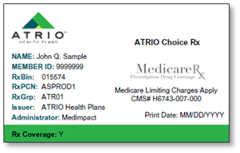
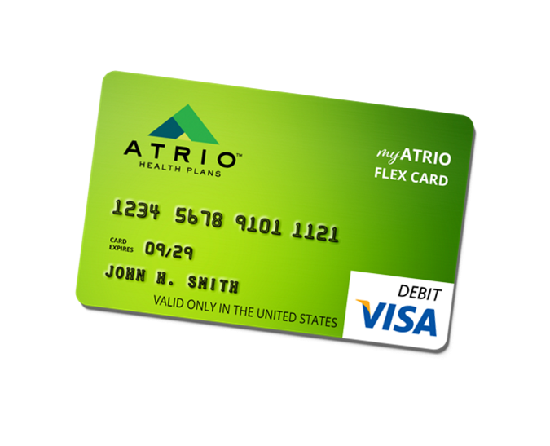
Member Experience
Member ID Card
This card will contain all your member information, including important numbers (i.e., Member Services contact information). Use this card for your doctors, hospitals, hearing, vision, and pharmacy visits.
Flex Card Visa Debit Card (no pin)
Your ATRIO Flex Card will be pre-loaded with allowances for dental, fitness, OTC and routine chiropractic/acupuncture/naturopathy services.
*Allowances and benefit periods vary by plan.
Confidential - Not Intended for Distribution

Slide 8
Your 2025 Benefits
Confidential - Not Intended for Distribution

Slide 9











Top plan benefits
Monthly premium
$0 - $116
Ambulatory Surgery Center Services
Ambulance
(air & ground)
In-Network:
PCP and Specialist Services
$0-$45
Annual Wellness Visit
$0 copay
Emergency and Urgent Care Services
Diagnostic Tests
Lab, X-Rays and Radiology Services
Worldwide Emergency
(Most plans)
Inpatient & Outpatient Hospital Care
*Copays, on medical services vary by plan.
Confidential - Not Intended for Distribution

Slide 10









Top plan benefits
Use your Flex Card: a special debit card preloaded with dollars for Dental, Fitness, OTC, and routine Alternative Therapies such as Chiropractic, Acupuncture, and Naturopathy services. No limitations on Network Providers, you choose your provider of choice on these services.
Your plan may include:
Routine vision benefits
$0 annual eye exam and $150-$200 eyewear (frames and lenses) allowance using the VSP Advantage Network
$0 for up to 2 meals per days for 14 days delivered after a qualifying event through Moms Meals
Dental Benefits
$400-$1,600 annual allowance on Dental benefits (allowances added every 3 or 6 months depending on plan choice). No rollover to the next benefit period.
Fitness Benefit
$175-$300 annual allowance every 6 months or annual for gym membership and fitness classes.
$0 annual hearing exam and discounts on hearing aids through Amplifon
Personal Emergency Response System (PERS)
Wearable medical alert system and monitoring through LifeStation. Wearables include wristwatch option with heart monitor and step counter (Not included in all plans)
OTC
$30-$150 quarterly allowance on your Flex card per benefit period to send on select health-related OTC items. Order items online, on the app, or purchase in-store at participating retailers.
$0 for 12 or 24 one-way rides to plan-approved health-related locations through SafeRide (Not included in all plans)
Routine Alternative Therapies (Chiropractic, Acupuncture, and Naturopathy) $100-$300 allowance every 6 months.
*Allowances on Extra Benefits vary by plan.
*Allowances and benefit periods vary by plan.
Confidential - Not Intended for Distribution

Slide 11

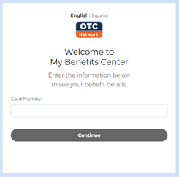


Flex Card
Explore your plan benefits online, anytime by visiting and or downloading these applications.
Using your Flex Card
Visit mybenefitscenter.com to view all benefit balances.
Swipe your Flex Card like a credit card to pay for your, Dental, Fitness, OTC, Routine Chiropractic, Acupuncture and Naturopathy Services.
Every time you use the Flex Card, the amount used will be deducted from your allowance.
View the OTC Catalog on the “Extra Benefits” page on atriohp.com or in your myATRIO portal.
To view your Flex Card balance, report a lost card, request a new card, or have other questions about the Flex Card benefit, call 1-800-371-2119 (TTY 711), Monday-Friday, 8 a.m. to 11 p.m. EST. Or visit your myATRIO member portal and click on the “Check my Balances” tile.
Download the OTC Network application on your phone to view:
  Search approved Retail locations
  OTC Balances
  Scan items to identify approved OTC items
Confidential - Not Intended for Distribution

Slide 12
Prescription Drug Coverage

Slide 13


Prescription Drug Coverage
Understanding Medicare drug payment stages
Your prescription drug costs change during the year, depending on which payment stage you are in. The payment stages start over on January 1 includingthe annual deductible stage and the dollar limits in each stage may change each year. The coverage limits are determined by benchmarks set by the Centers for Medicare & Medicaid Services (CMS).
Payment stages | Member typically pays | Plan typically pays
Annual Deductible | 100% until you reach the plan deductible | 0%
Initial Coverage | Your copay will depend on which tier the drug is in, check your formulary to the tiers and a list of covered drugs
Catastrophic Coverage Stage: After you have paid $2,000 out-of-pocket, you move to the Catastrophic Coverage Stage. In the Catastrophic Stage the plan pays 100% of your drug costs | $2,000 maximum | 100% after the $2,000 is met
Confidential - Not Intended for Distribution

Slide 14
Your Pharmacy Benefit
Your plan may include:
Some plans have a Part D Deductible, check your Summary of Benefits or EOC to see if your plan has a deductible.
$0 copay for all prescription drugs on the plan’s Drug List (Tier 1 & 6)
Pick up in-store at an in-network pharmacy or choose home delivery for convenient delivery right to you
$35 for 30-day supply of each insulin product, no matter what cost-sharing tier it is on, even if you have not paid your deductible
Manage your prescriptions online
Visit atriohp.com and go to the Members tile drop-down and select Find a Drug for more information.
Confidential - Not Intended for Distribution

Slide 15

Prescription Drug Coverage
Medicare Prescription Payment Plan Program (M3P/MPPP)
How it works
  All members with plans that include Part D (Rx) coverage are eligible to opt-in to the M3P program
  Members have the option to opt-in or opt-out of the M3P program at any time
  Members with high prescription costs are likely to benefit the most from the M3P program] [Members with prescription drug costs that total the annual maximum out-of-pocket of $2,000 or more in prior years benefit the most from the M3P program
  Members who enroll and qualify in the M3P program, will pay $0 to the pharmacy for covered Part D drugs
  Members will then be billed monthly by ATRIO Health Plans for the cost of their prescriptions. Calculations for monthly payments are based on the annual $2,000 out-of-pocket maximum as well as prescription costs incurred each prior month.
If you get Extra Help from Medicare with your Part D costs, you will be eligible for this program
Confidential - Not Intended for Distribution

Slide 16
Prescription Drug Coverage
How to Save Money on Drug Costs
Apply for “Extra Help”
Medicare provides “Extra Help” to help pay Part D premiums, deductibles and copays for people who have limited income and resources
Switch to a Formulary Drug or cheaper alternatives
Speak to an ATRIO Pharmacy Team Representative to see if a cheaper formulary alternative is available for you
Mail-Order/90-day supply
You can receive a 3-month supply of your Maintenace medications, delivered right to your doorstep, for only 2 copays.
  90-day supply also available at retail pharmacy
  Ask your doctor to write 100-day supply Rx
Patient Assistant Program or manufacturer coupon
This may depend on the drug, your income or state regulations
You can access your drug list by visiting atriohp.com or calling Member Services
Switch to a Generic Drug
Talk to your doctor about possible alternatives that may be a good fit for you
Confidential - Not Intended for Distribution

Slide 17
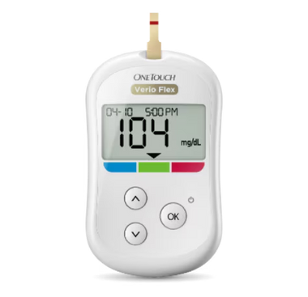
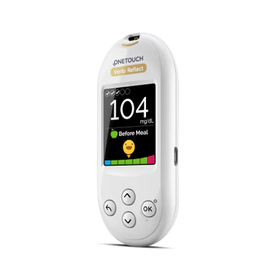


Prescription Drug Coverage
Diabetes Meters & Test Strips
OneTouch® (LifeScan) or Freestyle® (Abbott) are ATRIO preferred choices for Blood Glucose Meter & Strips with $0 out-of-pocket cost. Other brands will require prior authorization.
OneTouch Verio Flex® meter and OneTouch Verio Reflect® meter
Freestyle Lite & Freestyle Freedom Lite
Continuous Glucose Monitors (CGM)
ATRIO Health offer two CGM systems that are preferred to its members. Dexcom and Freestyle Libre. These systems are used to continuously monitor blood sugar levels in members who require more frequent testing to control their blood sugar levels. CGM supplies will require an approved prior authorization for coverage.
Talk to your doctor about choosing the appropriate brand-name meter for you.
For more details, call Member Services or visit:
atriohp.com

Slide 18
Connect to care

Slide 19






Connect to Care
Choosing a primary care provider (PCP) is important, your PCP can help you manage your health and:
  Make smart, healthy lifestyle choices
  Coordinate Specialist care
  Prescribe necessary medications
  Important preventative care
Visit atriohp.com to find a PCP or specialist near you.
Know when to go to your doctor, urgent care or the emergency room.
Visit your Primary Care Provider(PCP) for:
  Routine care
  Medication Management
  Annual Wellness visits
  Health screenings
  Immunizations
Go to an Urgent Care Center when you can’t see your PCP for non-emergencies, like:
  Sprains
  Minor infections or burns
We encourage members to reach out and schedule your wellness appointment right away. Connecting with your doctor early is the first step to managing your health care needs.
  Sudden illness
  Minor broken bones
Go to the Emergency Room for very serious health issues like:
  Heavy bleeding
  Chest pain
  Major burns
  Breathing difficulty
You don’t need a referral to get care from other providers. If you get care from other providers, let your primary care provider (PCP) know so they can coordinate your overall care.
  Sudden confusion or weakness on one side of your face or body
Call 911 if you’re not able to get to the emergency room.
Confidential - Not Intended for Distribution

Slide 20





Connect to Care
You may receive a direct call from our health coverage partners to help navigate the best health goals for you.
Health Assessment Survey
You may have received a Health Assessment Survey in your enrollment packet or mailed to you by ATRIO. It has questions about your current health status which helps us to identify areas that we can better assist you. Please make sure to fill this out and send back to ATRIO.
Helping you live your healthiest life
Visit or speak with your PCP for preventative and routine care. They are your best source for managing complexities of your health care and help you:
  Annual wellness
  Immunizations; Vaccines, including Shingles
  Flue/pneumonia shots
  Preventative screenings
    Colon or prostate cancer screening
    Mammogram screening
    Diabetic screenings
Diabetes Prevention Program
We identify qualified members to provide practical training for overcoming challenges to sustaining weight loss and lliving a healthy lifestyle. You may be contacted by ATRIO if you qualify for this program.
Medication Therapy Management
Understanding your medications and taking them the right way is important for your health. The MTM program is designed to help members get the most benefit from their medications if they meet the criteria. A pharmacist from our program will reach out to you to:
  Reviewing vitamins or over-the-counter medicines and medications for chronic conditions like diabetes
  Work with your doctors to reduce side-effects of medications or potential interactions that can be harmful to your health
  Look for ways to reduce your drug costs
Telehealth visits,
If your provider offers telehealth services, copays vary by plan, it matches the PCP and Specialist copays for In-Network and Out-of-Network. Provider must offer telehealth services.
*Telehealth copays vary by plan
Confidential - Not Intended for Distribution

Slide 21
Connect to Care
You may receive a direct call from our health coverage partners to help navigate the best health goals for you.
Preventive Care
In-home Lab Testing & Wellness Assessment
ATRIO partners with several companies that may reach out to offer a yearly in-home wellness review or in-home lab testing kits for preventative measures, which are mailed directly to your home and returned with pre-paid postage. Take advantage of these offers.
Health Assessment Survey
You may have received a Health Assessment Survey in your enrollment packet or mailed to you by ATRIO. It has questions about your current health status which helps us to identify areas that we can better assist you. Please make sure to fill this out and send back to ATRIO.
Diabetes Prevention Program
We identify qualified members to provide practical training for overcoming challenges to sustaining weight loss and lliving a healthy lifestyle. You may be contacted by ATRIO if you qualify for this program.
Helping you live your healthiest life
Visit or speak with your PCP for preventative and routine care. They are your best source for managing complexities of your health care and help you:
  Annual wellness
  Immunizations; Vaccines, including Shingles
  Flue/pneumonia shots
  Preventative screenings
    Colon or prostate cancer screening
    Mammogram screening
    Diabetic screenings
Medication Therapy Management
When you take the right medicines in the right way for the right health conditions, they are safe and effective tools for good health. ATRIO partners with MedWiseRx to improve your health by:
  Reviewing vitamins or over-the-counter medicines
  Working alongside your doctor to help navigate your medications
  Looking for ways to cut drug costs for you

Slide 22
Member Resources

Slide 23

Member Resources
Member Portals
myATRIO Portal allows members to access tools to help navigate their ATRIO benefits, pay plan premiums, check Flex Card balances, and access ATRIO benefits like, OTC, vision, transportation, and more!
Member Services
Contact Member Services with questions on your Plan Benefits, Claims, Lost/Stolen Member ID or Flex Cards, Provider Search, Pharmacy Team Assistance plus more! Open daily, 8 a.m. to 8 p.m. PST. Or you can send a message at CustomerService@atriohp.com or use the Chat function at atriohp.com to chat with a Member Service Representative, Mon-Fri, 8:30 a.m. -5:00 p.m.
Visit atriohp.com and visit the myATRIO button to begin your account registration process. A demo video is also available to help navigate the registration process.
atriohp.com
Access Member Portal, Member Services representative chat function, plan information, online provider directory, pharmacy search tools, member forms, plus more!
Members can also access the Prescription Drug Portal from myATRIO to view:
  Current prescription drugs
  Prior authorizations
  Refill a specialty prescription
  View prescription drug benefit accumulators
  Find a pharmacy
Member Meetings
Stay in the know with our Member Meetings offered in select markets. Visit atriohp.com Members Tile and view upcoming member meetings in your area.
Confidential - Not Intended for Distribution

Slide 24
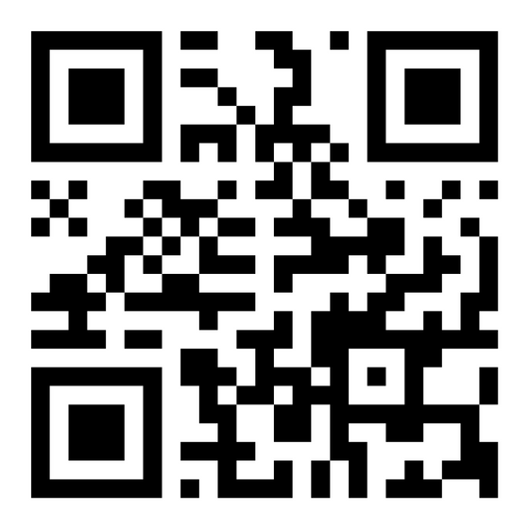
Tip: Collaboration makes teamwork easier! Click "Share" and invite your teammates to fill this up. Use this page for bulletins, brainstorms, and other fun team ideas.
Right-click on the background of the slide, or on the thumbnail below, for the option to expand this page into a whiteboard for more space!
Visit the ATIRO website and Member Portal, myATRIO for all your Member Needs.
ATRIO website
Scan this QR code or visit
atriohp.com

Slide 25

I’m here for you!
When you have questions, I have answers.
[Enter Name] [Enter Title] | [Enter Name] [Enter Title]
Telephone T: [123-456-7890] Email [hello@reallygreatsite.com] ATRIO Website www.atriohp.com | Telephone T: [123-456-7890] Email [hello@reallygreatsite.com] ATRIO Website www.atriohp.com
ATRIO Health Plans is a PPO, HMO, PPO C-SNP, and HMO D-SNP with Medicare and Oregon Health Plans contracts. Enrollment in ATRIO Health Plans depends on contract renewal.
Confidential - Not Intended for Distribution
To file a grievance or compliant about marketing efforts with Medicare, contact 1-800-MEDICARE, 24 hours a day/7 day a week. Please provide your agent/broker’s name and plan if possible.
Y0084_MKG_MPres_2025_M

Slide 26


Thank You!

